Slide 1
QA – PROCESS RULES TRAINING
MAP-ID BENGALURU
MUSASHI RULES TRAINING
TOPIC : PROCESS RULES
MUSASHI AUTO PARTS INDIA PVT. LTD.
BENGALURU PLANT

Slide 2
IPP – Initial Production Part

Slide 3
IPP – Initial Production Part

Slide 4
IPP – Initial Production Part

Slide 5
IPP – Initial Production Part

Slide 6
IPP – Initial Production Part

Slide 7
IPP – Initial Production Part

Slide 8
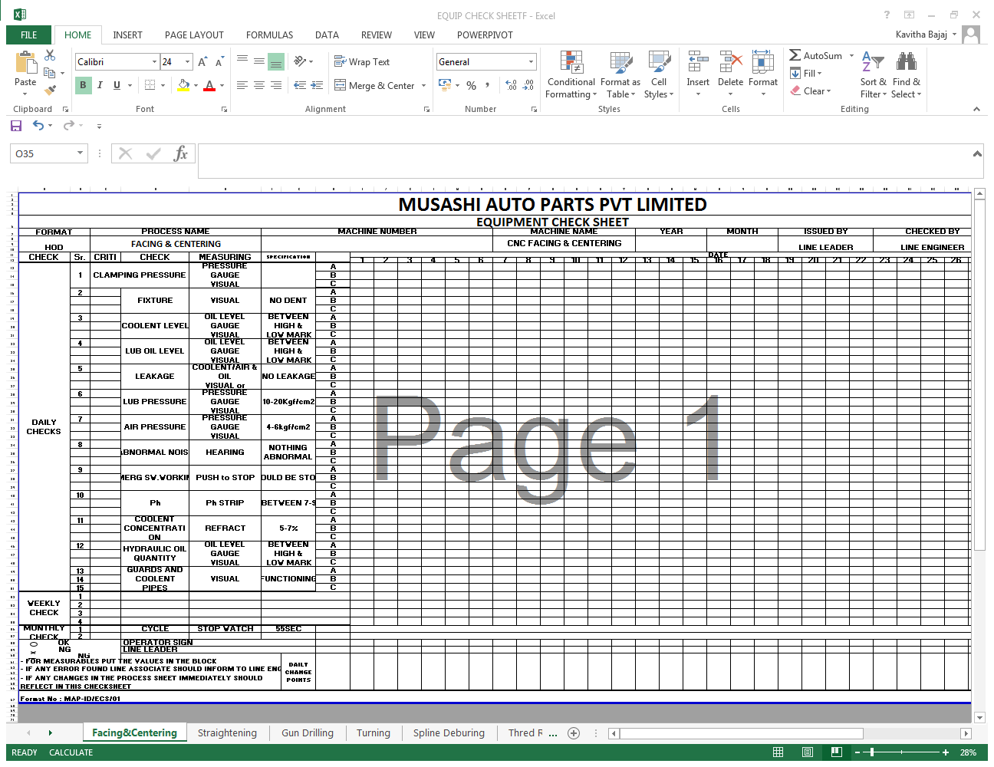

TPM SHEET / MACHINE (EQUIPMENT) CHECK SHEET

Slide 9
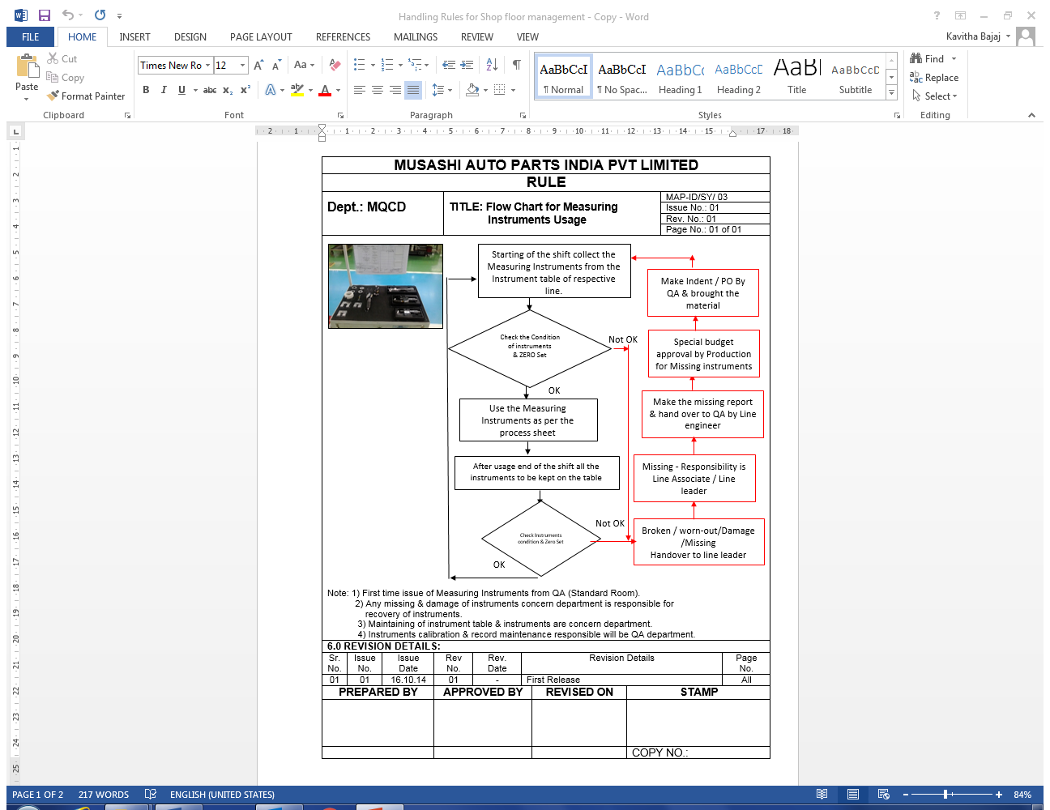
MEASURING INSTRUMENTS USAGE RULE

Slide 10
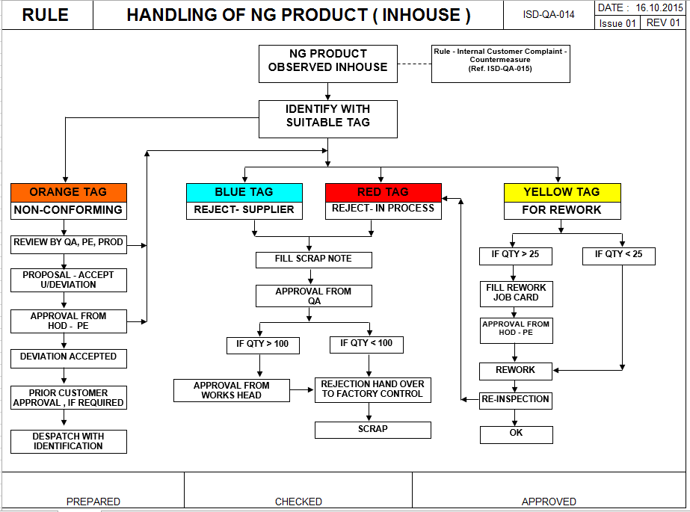
NG PRODUCT HANDLING RULE

Slide 11
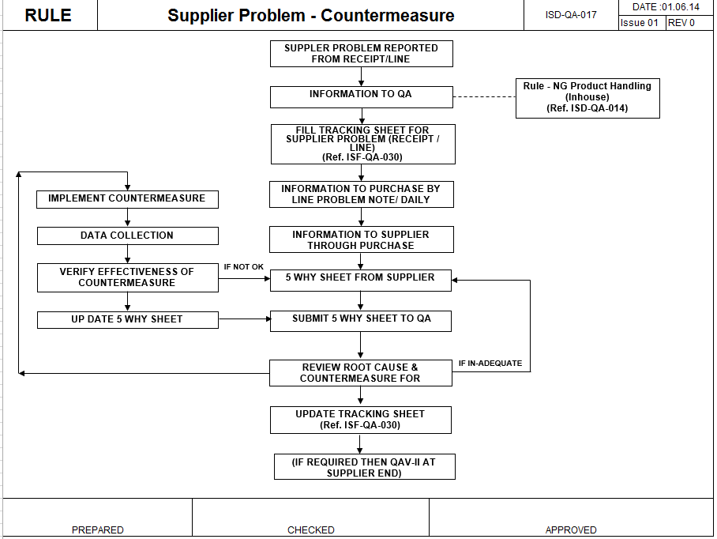
COUNTERMEASURE FOR SUPPLIER PROBLEM

Slide 12
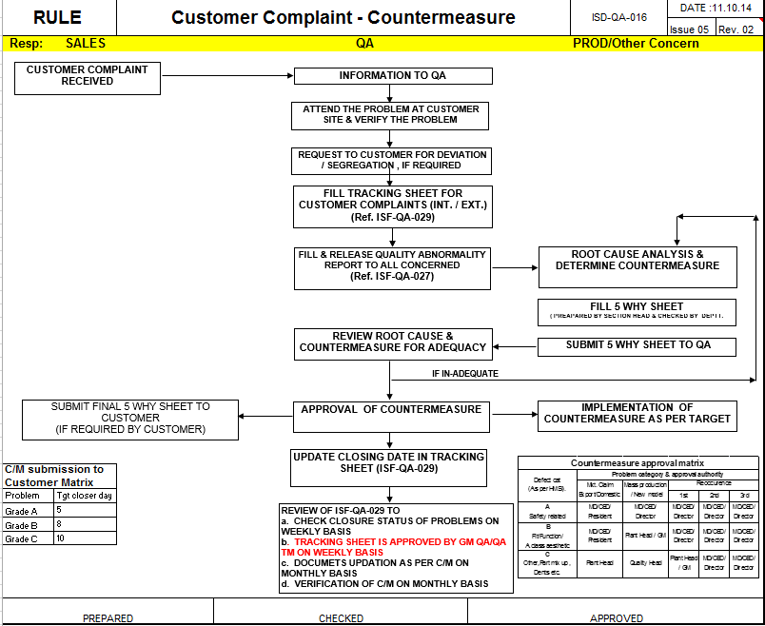
COUNTER MEASURE – CUSTOMER COMPLAINT

Slide 13
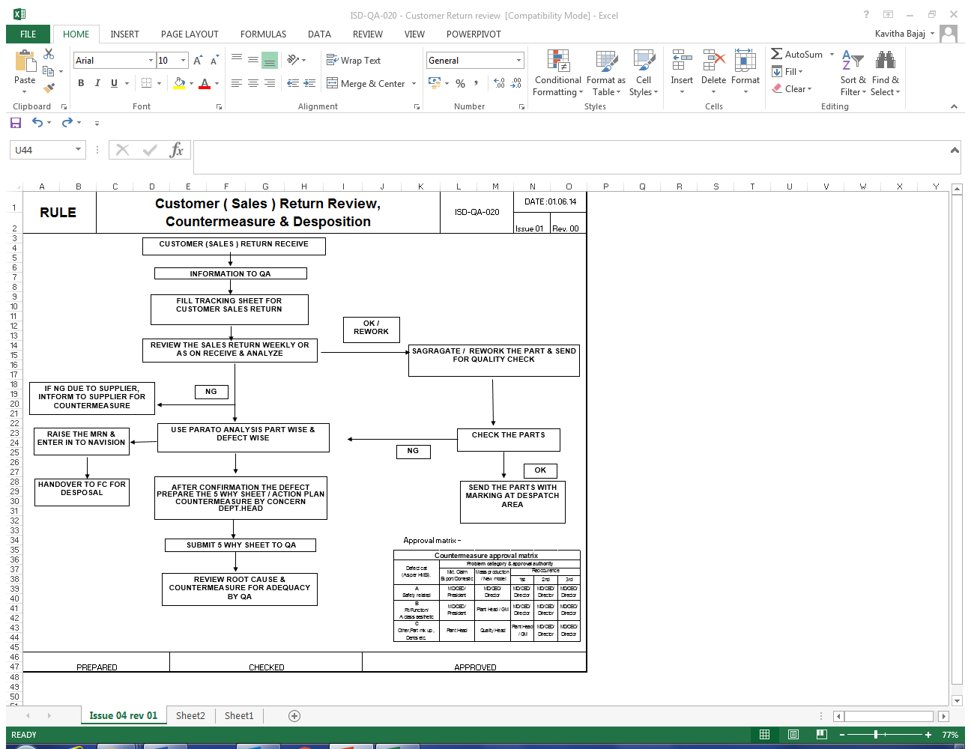
SALES RETURN RULE

Slide 14
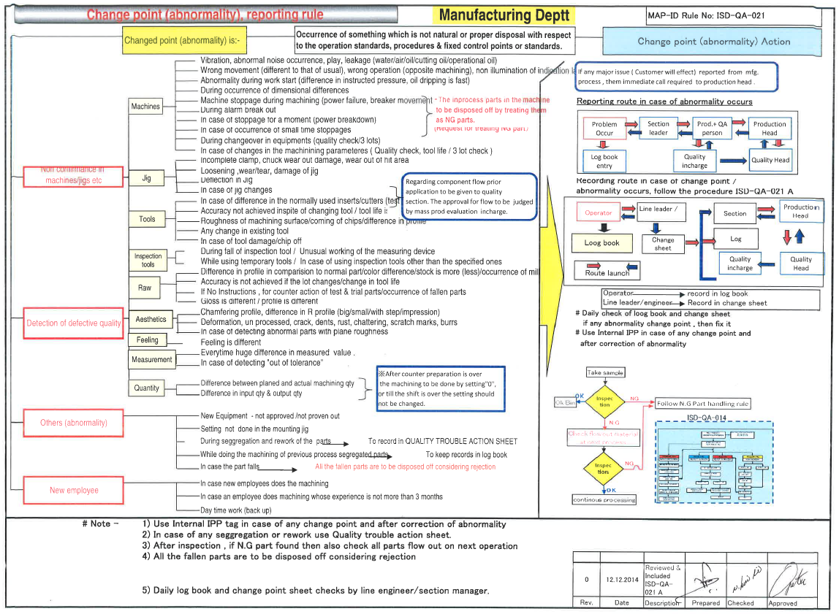
ABNORMALITY RULE

Slide 15
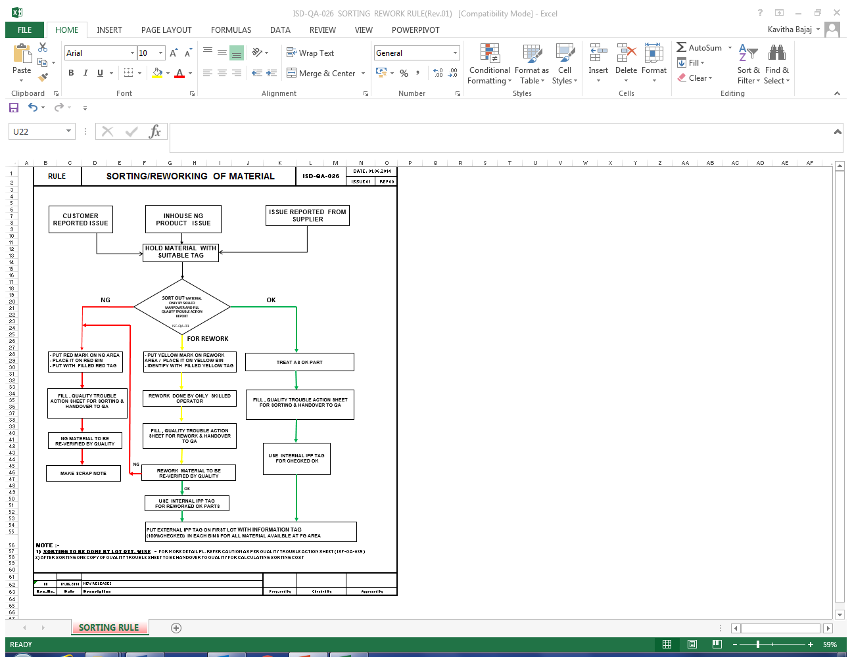
SORTING/REWORK RULE

Slide 16
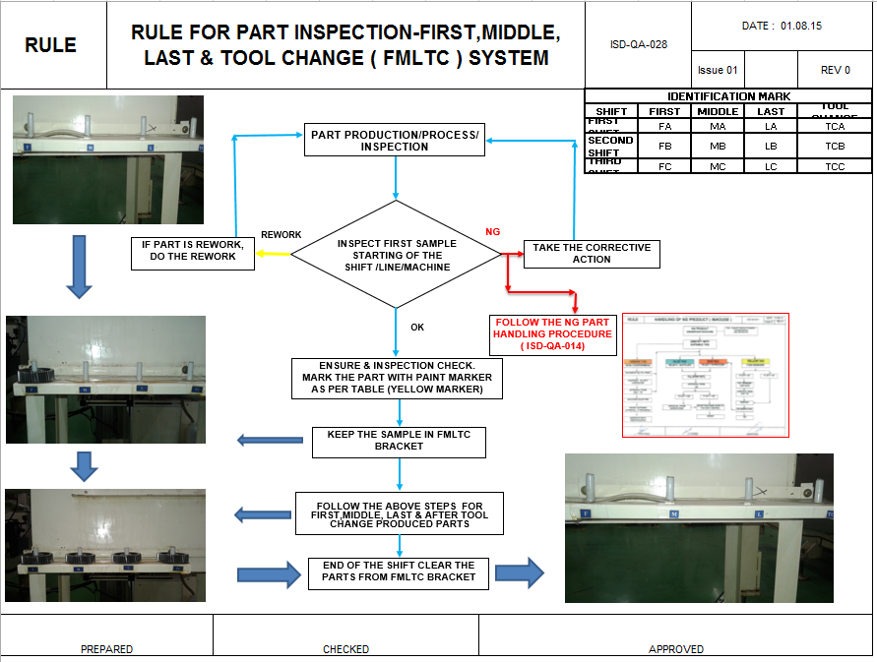
PART INSPECTION RULE

Slide 17
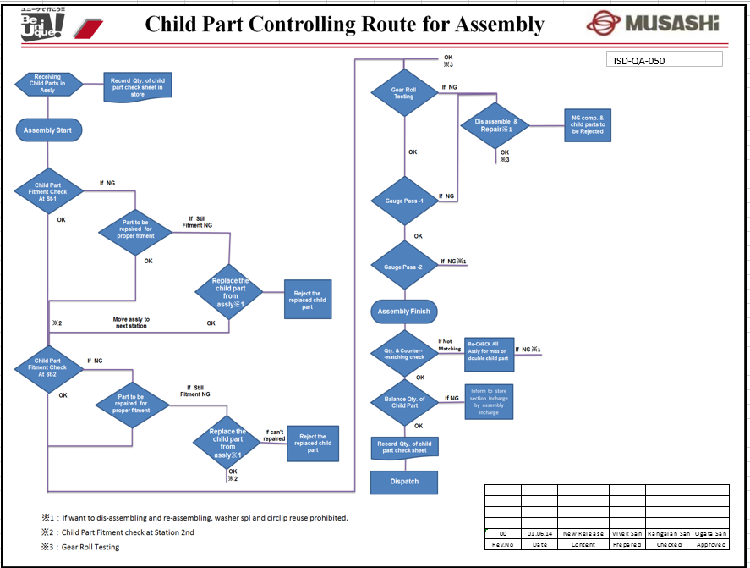
CHILD PART CONTROLLING RULE

Slide 18
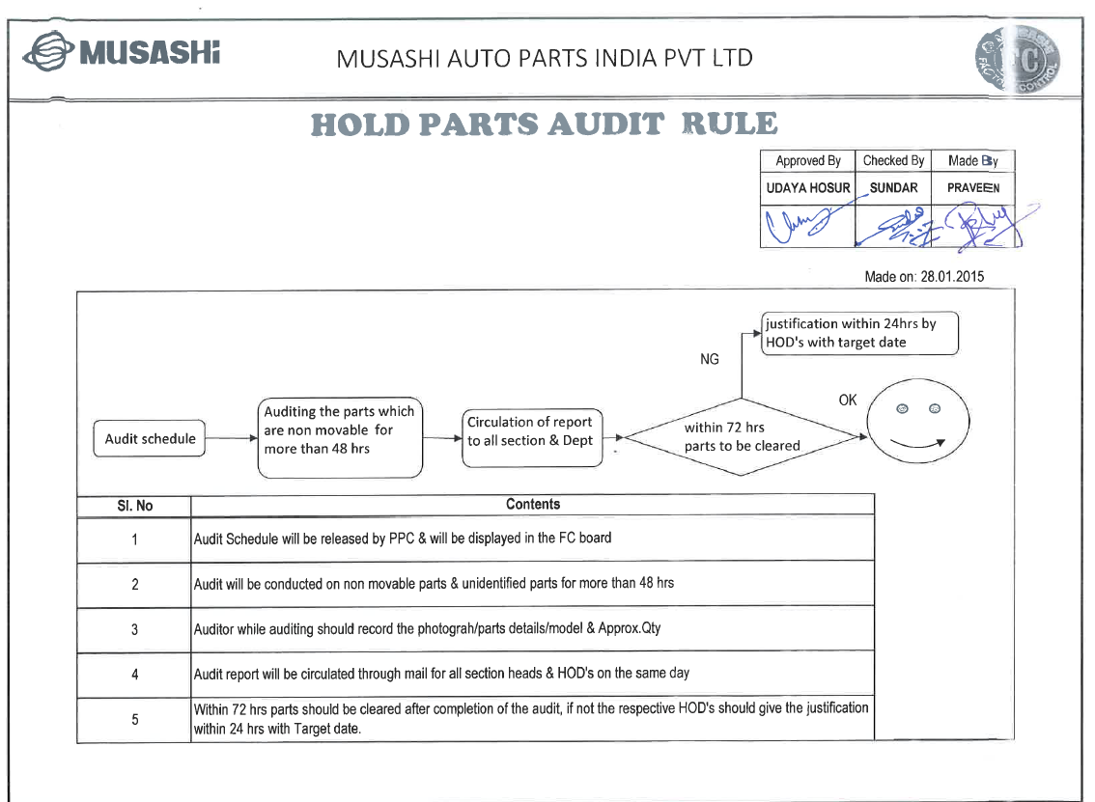
HOLD PARTS AUDIT RULE

Slide 19
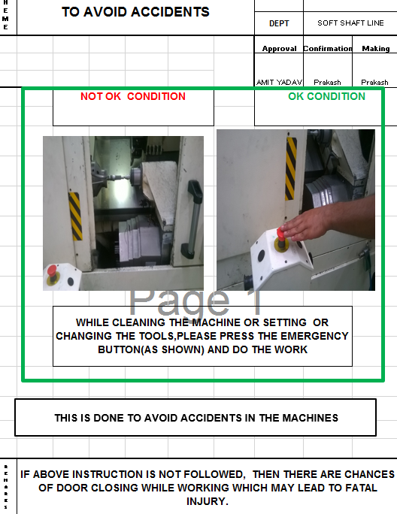
ONE POINT LESSON – AVOID ACCIDENTS

Slide 20
ONE POINT LESSON – OPL -

Slide 21
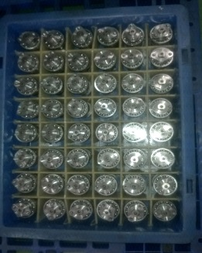
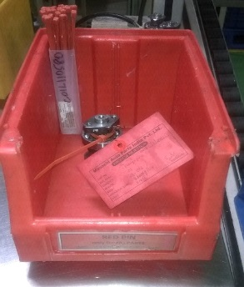
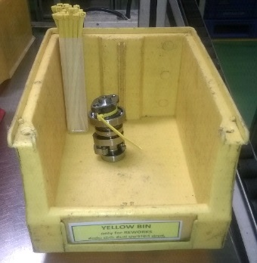
ONE POINT LESSON – OPL -
ONE POINT LESSION
T
OK PARTS
AND
NG PARTS
Ｎｏ．
OPL/15-16/MS 2
H
E
HANDLING
M
E
ENGINEER
SECTION HEAD
HOD
SUBHASHREE
NAGESH SAN
AMIT SAN
OK PARTS
NG PART
REWORK PART
OK
PARTS NEED TO KEEP IN
NG PARTS NEED TO KEEP
FOR REWORK PARTS
NEED TO
BLUE BIN WITH LOT TAG
IN RED BIN WITH RED
TAG
KEEP IN YELLOW BIN WITH TAG
NOTE:AFTER
CAM ASSLY 60 BINS OF OUTPUT BLUE BIN PRODUCTION COMPLETE THE OK PARTS NEED TO MOVE
TO FC AREA
CHECK
VISUALLY 100%
AND CHECK THE LINE TO AVOID FLOW OF NG PART
R
E
M
IF ABOVE INSTRUCTION NOT FOLLOWED NG PART MAY OUTFLOW TO CUSTOMER.
A
R
K
S
C
H
E
C
K
C
O
L
U
M
N

Slide 22

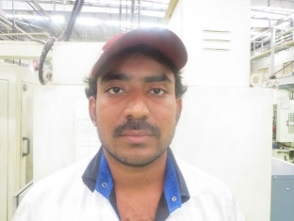
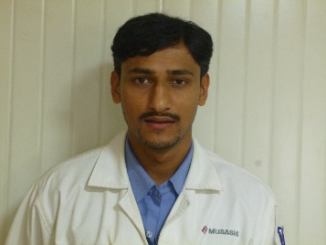
WORKING RULES – HANDLING INSTRUMENTS
SANTOSH
KIRAN
GIRISH.K

Slide 23
WORKING RULES – HANDLING TROLLEYS
SANTOSH
KIRAN
GIRISH.K

Slide 24

WORKING RULES – 5 SENSE ORGANS USAGE
SANTOSH
KIRAN
GIRISH.K

Slide 25
WORKING RULES – HORENSO - COMMUNICATION
SANTOSH
KIRAN
GIRISH.K

